Slide 1
Magic Mirror Module
Basic Set up for ServerOnly operation

Slide 2
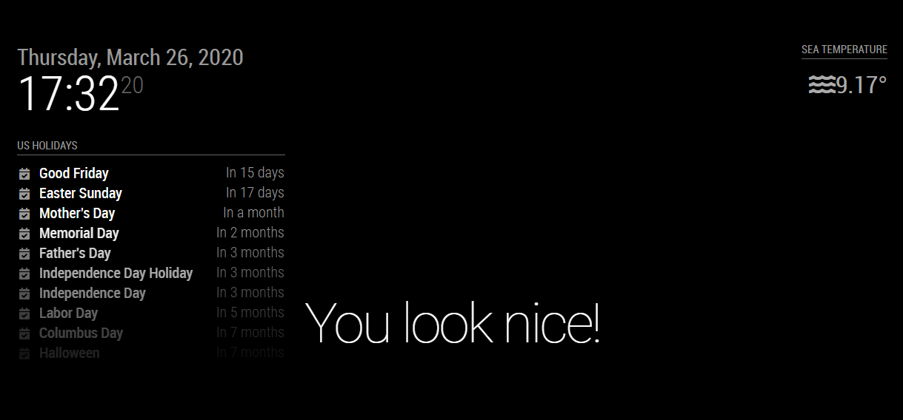
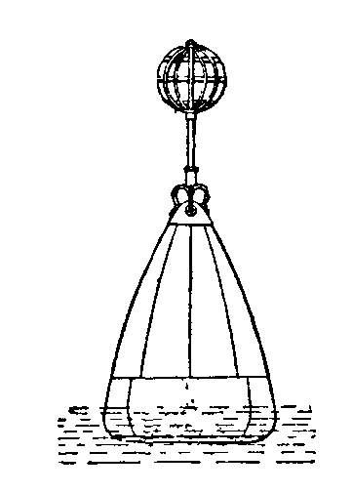


What we’ll make…
Magic Mirror
M5 Buoy

Slide 3
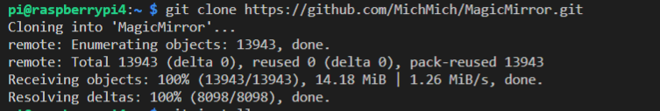
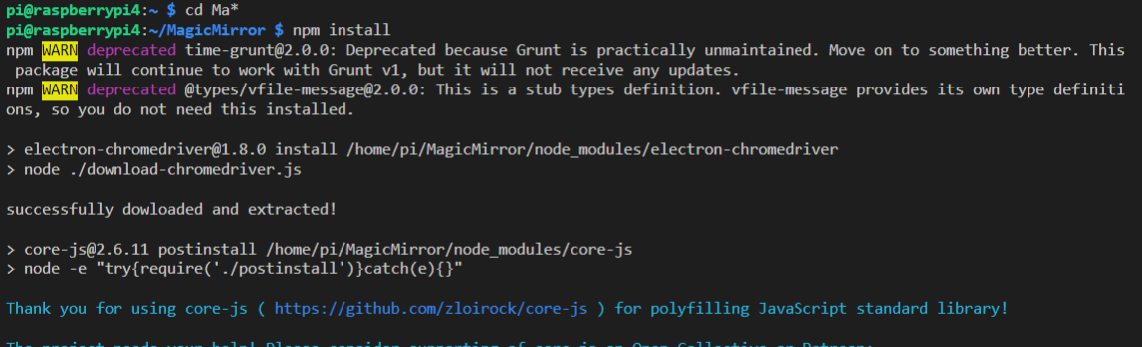
1. Clone and Install Magic Mirror

Slide 4
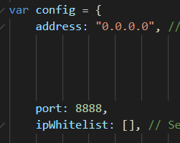











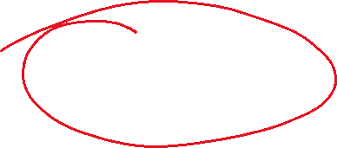












Update /config.config.js

Slide 5
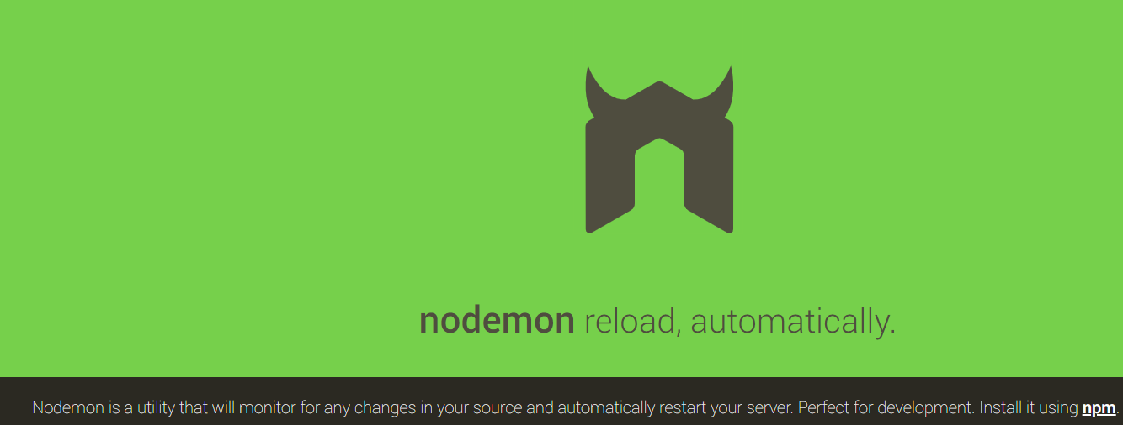
Install Nodemon
Saves you having to restart every time you change code

Slide 6
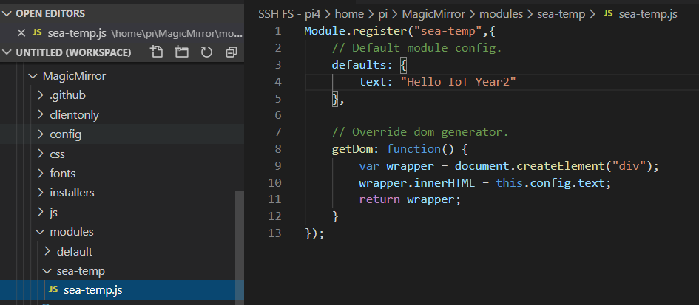






Create Simple Module

Slide 7
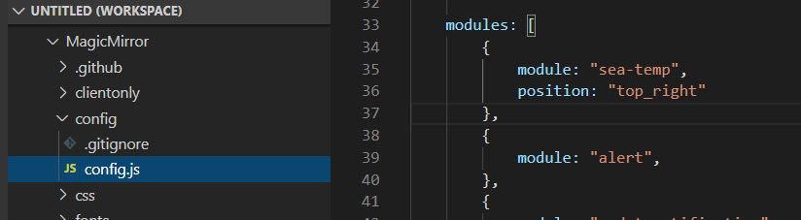


Update /config/config.js

Slide 8
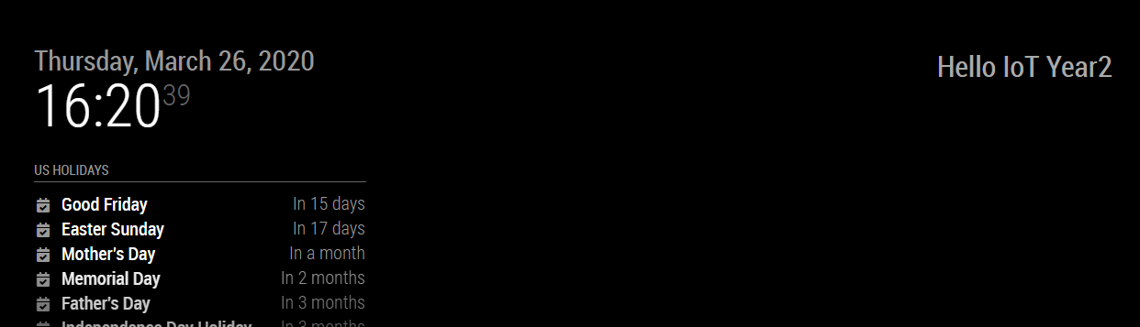

Test It!

Slide 9
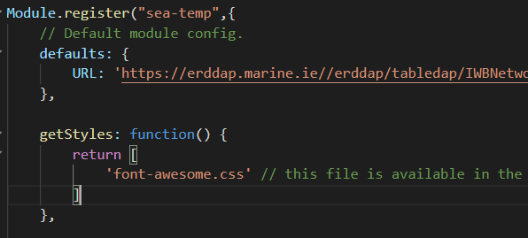
Enhance the Module: Get data from M5 buoy
Include URL and pull in css style sheet

Slide 10
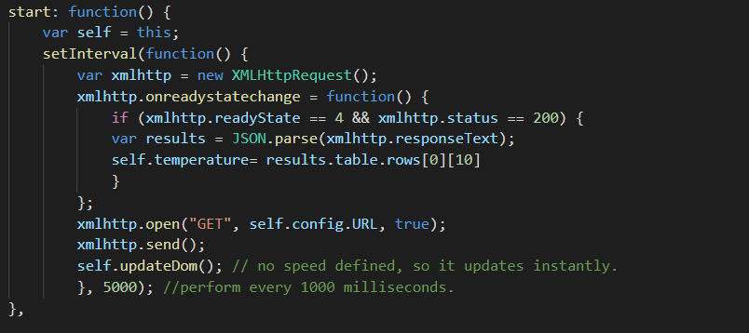
Enhance the Module: Get data from M5 buoy
Specify Start function that requests M5 data every 5 seconds

Slide 11
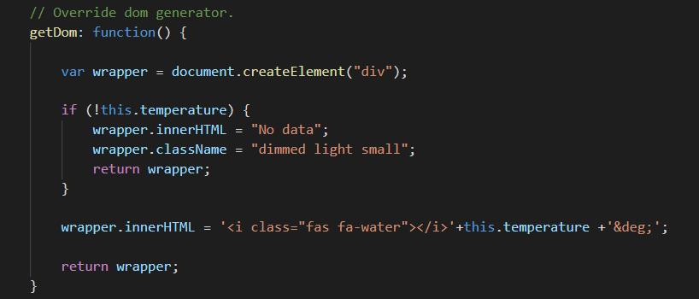
Enhance the Module: Get data from M5 buoy
Update getDom function to check for temperature and display

